Slide 1

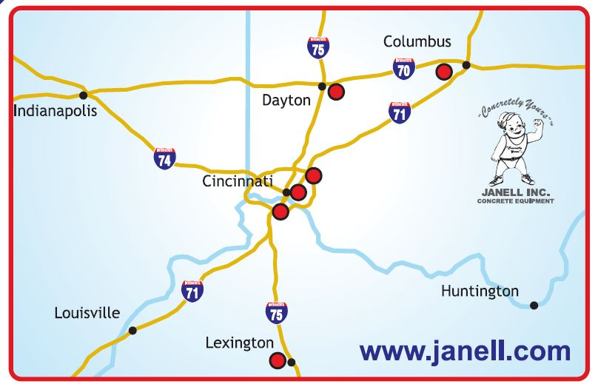

We The
People
C O V E R A G E
INTERSTATE
Delivering Same Day To: OH, KY, IN, WV
C O U N T S !
Cincinnati Norwood Erlanger Dayton Columbus Lexington
6130 Cornell 4686 Paddock 2930 Crescent Sprgs 801 E. St. 831 Harmon Ave. 970 W. New Circle Rd.
45242 45229 41018 45402 43223 40511
513-489-9111 513-651-9111 859-341-9111 937-866-9111 614-224-9111 859-254-9111

